Slide 1


Counseling Strategies
Tri-Service Hearing Technician
4.2 Certification Course

Slide 2
Counseling Strategies
Learning Objectives
3.1.1 Describe the importance of counseling
3.1.2 Counsel a patient on their audiogram using common terms
3.1.3 Describe the required follow-up steps for an initial STS identification and/or referrals
3.1.4 Outline techniques that will allow for group explanation of test results that will not violate HIPAA requirements
3.1.5 Demonstration
Tri-Service Hearing Technician 4.2 Certification Course

Slide 3
Counseling Strategies
Health Insurance Portability/Accountability Act (HIPAA)
Impacts all patient care
Protects individual’s rights to privacy and confidentiality
Assures the security of electronic transfer of personal information
Applies in hearing conservation
  Employers, i.e. DoD, who paid for the exam and are conducting the exam to be compliant with Federal regulations may have access to the record without consent of the employee
  Information reported must be limited to information that is required by the agency
  Successful completion of HIPAA electronic training prior to any audio testing
Tri-Service Hearing Technician 4.2 Certification Course
Notes:
Ensure discussions regarding individual PHI are not overheard
Do not conduct discussions in open areas: elevators, cafeterias, etc.
Protect computer screen from outsider’s view, logout when departing work station

Slide 4

Counseling Strategies
Health Insurance Portability/Accountability Act (HIPAA)
Develop group counseling strategies that conform to HIPAA
  Counseling sessions in a multi-test station clinic
  High volume clinics necessitate explanation of test results in groups
  Group counseling sessions create a potential for HIPAA violations
Consults/Referrals
STS notifications to patient’s chain of command
Tri-Service Hearing Technician 4.2 Certification Course
Notes:
Image: https://static1.squarespace.com/static
HIPPA creates ramifications for multiple clinic actions

Slide 5
Counseling Strategies
Counseling and education is one of the most effective ways to get noise exposed personnel into becoming more involved in their role as a member of the HCP team
Give patient their audiogram
  Is there a change in hearing? Yes/No Positive/Negative
  Are thresholds within the range of normal?
  Where does the patient need to go?
Discuss the dangers of hazardous noise and that noise-induced hearing loss is preventable
Review the importance of periodic audiograms and/or schedule follow-up testing/evaluation
Tri-Service Hearing Technician 4.2 Certification Course
Notes:
A noise exposed person that understands their injury is one that will work to diminish further progression

Slide 6
Counseling Strategies
Training/Education/Motivation
Elements and rationale of the HCP
Effects of noise on hearing (occupational and non-occupational)
Purpose, styles and proper use of various HPDs
  Otoscopic exam and fit HPDs
Command and employee responsibilities for HC
Impact hearing loss may have on career, safety and mission
Purpose of hearing tests and procedures
  Review/Explain Audiogram
Service-specific requirements
Tri-Service Hearing Technician 4.2 Certification Course

Slide 7
Counseling Strategies
Overview
Brief HIPAA review
Efficient & Effective group counseling strategy
Audiogram explanation for patients
Counseling difficult patients
Referrals to an audiologist/provider and baseline re-sets
Group counseling demonstration
Practical exercise
Tri-Service Hearing Technician 4.2 Certification Course

Slide 8
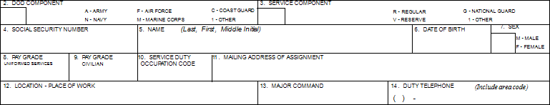
Counseling Strategies
Overview
Ensure blocks (fields) 2-14 are correct
Personal information correct?
Unit information?
Any changes to the audiogram need to occur in the edit audiogram window not the run test window
Tri-Service Hearing Technician 4.2 Certification Course
Notes:
Demographic data fields are correct (#2-14), briefly review each field; any changes to the NHC (no Form number) DD Form 2215/2216 are required to be corrected in the audiogram edit screen.

Slide 9
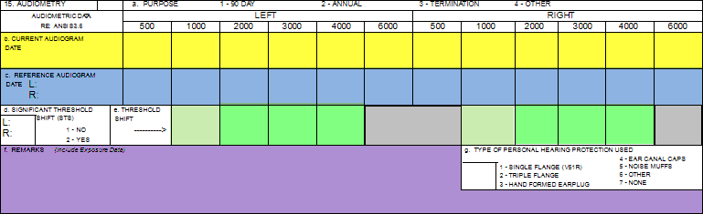
Counseling Strategies
Audiogram
Tri-Service Hearing Technician 4.2 Certification Course
Notes:
Yellow = current audiogram
Blue = reference audiogram
Dark Green = differences between current and reference audiogram (STS)
Light Green = differences between current and reference audiogram (EWS)
Purple = remarks
Remarks on the 2216 are specific to the latest test on the 2216

Slide 10


Counseling Strategies
Audiogram
Simplify terms for patients - avoid jargon
  Use pitch in place of frequency
  Women/Children voice - high frequency
  Men voice - low frequency
  Use loudness in place of intensity
Describe test results, rather than thresholds
  Explain frequencies (i.e., pitches) in terms of piano keys
  Compare thresholds (i.e., test results) the lower the number, the better you can hear
Tri-Service Hearing Technician 4.2 Certification Course
Notes:
Review major components: left/right ear, frequency, intensity
Use common language as patients do not have context for the audiogram
Compare common knowledge to help the patient understand the number values
Images: https://www.golfkinsale.com/images/dynamic/getImage.gif?ID=100003383; (notes, piano and speaker) – shutter stock (DoD account)

Slide 11
Counseling Strategies
Group Counseling Strategy
Have visual aids to help explain results
Review and prepare audiograms
Print and review test results prior to assembling patients for counseling
Identify individuals with problem audiograms that will require follow-up or referral
  You will need to meet individually with them
  Be careful not to “call them out” in front of peers or other patients
Provide verbal guidance that results are confidential, patients must view only their results
Tri-Service Hearing Technician 4.2 Certification Course
Notes:
Be effective and efficient; group patients so all can see/hear the examiner; Ask those that have questions to remain, review audiogram/question individually; let those that do not have issues go, letting them know they need to return in a year for their next audiogram.
Audiograms should be highlighted in advance for those requiring additional individualized counseling.

Slide 12
Counseling Strategies
Group Counseling Strategy/Serial Audiogram Orientation
Distribute tests
  Caution patients to respect others’ privacy
  Protect medical information
Verify demographic information (visual aid)
  Ask patients to review blocks 2-14 for accuracy
Mark top of any audiograms that requires data to be edited or fixed
Frequencies tested for left/right ears
Current test result fields
Tri-Service Hearing Technician 4.2 Certification Course

Slide 13
Counseling Strategies
Group Counseling Strategy/Serial Audiogram Orientation
Intensity explanation
  Lower numbers = better hearing
  Normal hearing parameters
Baseline results explanation
Normal test-retest differences
  Definition of a significant threshold shift
  Is there a change in hearing (STS)
  Is there a early warning shift (EWS)
Tri-Service Hearing Technician 4.2 Certification Course
Notes:
Be effective and efficient; group patients so all can see/hear the examiner; Ask those that have questions to remain, review audiogram/question individually; let those that do not have issues go, letting them know they need to return in a year for their next audiogram.
Audiograms should be highlighted in advance for those requiring additional individualized counseling.

Slide 14
Counseling Strategies
Group Counseling Strategy
Retain:
  Those who have questions
  Those requiring further evaluation (highlighted forms)
Individually review abnormal results with patient
  Maintain privacy
  Provide instructions for follow-up procedures
  Obtain patient signature for test results (as applicable)
Provide referral information (as applicable)
Tri-Service Hearing Technician 4.2 Certification Course
Notes:
Ask those that have questions to remain, review audiogram/question individually; let those that do not have issues go, letting them know they need to return in a year for their next audiogram.
Audiograms should be highlighted in advance for those requiring additional individualized counseling.

Slide 15
Counseling Strategies
Retest and/or Referrals
Problem Audiograms (DD 2215/2216 or NHC)
Follow Professional Supervisor guidance on referrals to audiologist or physician for further evaluation
Instruct patient to be 14 hours hazardous noise-free prior to any Follow-up or diagnostic testing
Ensure patient understands where to report to: audiologist, hearing technician and/or medical physician
Tri-Service Hearing Technician 4.2 Certification Course

Slide 16
Counseling Strategies
Retest and/or Referrals
DD 2216 positive STS
  Follow Professional Supervisor guidance on retesting and referrals for additional evaluation
  Potential conductive issues, i.e. cerumen impaction, should be addressed and resolved prior to retest
  Complete follow-up testing as soon as possible
  All positive STS follow-up tests require the patient to be at least 14 hours hazardous noise-free
DD 2216 negative STS
  Review audiometric history
  Immediately retest if needed
Tri-Service Hearing Technician 4.2 Certification Course
Notes:
Positive STS follow-up time frames: all civilians and USAF regular = 30 days; USAF reserve/NG = 60 days; USA, USN, USMC, USCG military 90 days. This is a brief overview of what the technician needs to tell the patient about follow-up requirements: Ensure patient understands where to report for f/u test or evaluation - audiologist, hearing technician or medical physician. Negative STS normally occur the first audiogram after an invalid reference audiogram was established, do not retest if previous reference was established by an audiologist and/or pay attention to headphone placement, positive STS on one ear, negative STS on the other.

Slide 17
Counseling Strategies
Group Counseling Demonstration
Group counseling 8 patients
  6 patients do not have an STS or audiometric changes
  1 patient has a negative STS
  1 patient has a positive STS
Conduct an efficient and effective group counseling session
  All patients have a basic understanding of test results
  HIPAA is maintained
  Patients with STS receive correct follow-up testing and/or additional guidance
Tri-Service Hearing Technician 4.2 Certification Course
Notes:
Use next three slides for demonstration

Slide 18
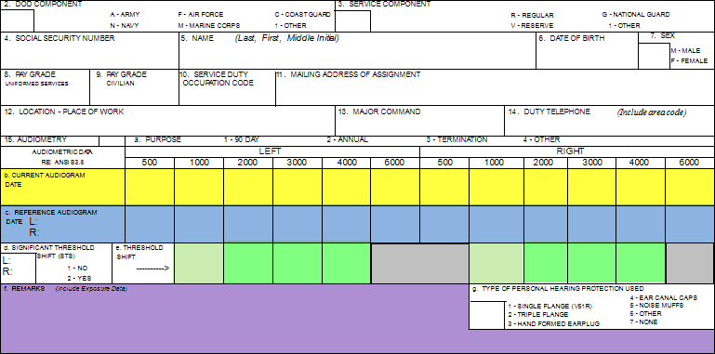
Group Counseling Demonstration
Notes:
Audiogram Orientation
Have all patients review demographic data, blocks 2 through 14, review each
Then review block 15, the lower the numbers the better the hearing:
Yellow = current audiogram
Blue = reference audiogram
Dark Green = differences between current and reference audiogram (STS)
Light Green = differences between current and reference audiogram (EWS)
Purple = remarks
Remarks on the 2216 are specific to the latest test on the 2216
Release all those with no issues, (6) state their need to return in 1 year and continue to wear HPDs when exposed to hazardous noise
Technicians need to pay attention to conductive, sensorineural, mixed hearing loss and patients that are not being cooperative
Note: any changes required need to occur in the edit audiogram window

Slide 19
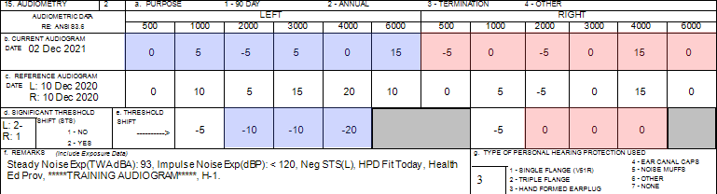
Counseling Strategies
Group Counseling Demonstration
[SSN = 990990001] Is there a change in hearing (ear specific)? (page 94)
Are thresholds within the range of normal (ear specific)?
Where does the patient need to go?
Additional Comments?
Notes:
Negative STS - Airman initial annual test after reference was established; results meant to provide an example of a patient who requires individual counseling for follow-up requirements of a negative STS; good policy to review audiometric history; Retest while counseling other patients retest

Slide 20
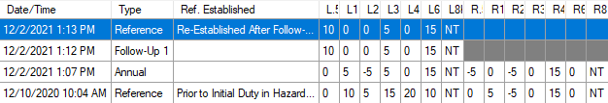
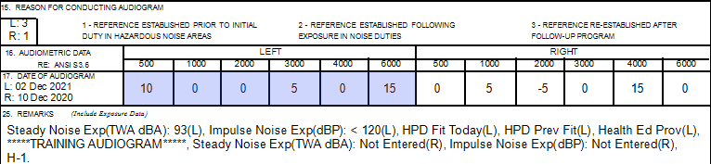
Counseling Strategies
Group Counseling Demonstration
[SSN = 990990001] Are thresholds within the range of normal (ear specific)? (page 94)
Where does the patient need to go?
Additional Comments?
Notes:
Negative STS - Airman initial annual test after reference was established; results meant to provide an example of a patient who requires individual counseling for follow-up requirements of a negative STS; good policy to review audiometric history; -STS still present, application auto re-established baseline with Follow-up 1 results. Student can look at data in their own database, viewing the 990990001 DD Form 2216 initial, follow-up test and re-established baseline in the print window to observe/review

Slide 21
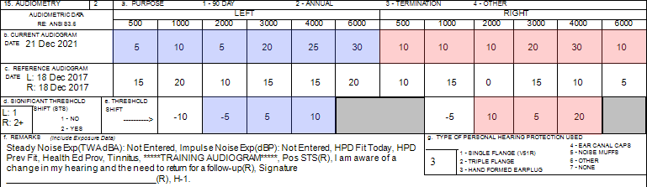
Counseling Strategies
Group Counseling Demonstration
[SSN = 990990021] Is there a change in hearing (ear specific)? (page 95)
Are thresholds within the range of normal (ear specific)?
Where does the patient need to go?
Additional Comments?
Notes:
Patient history - enjoys going to the range to fire weapons, left-handed shooter, previously seen by an audiologist for Asymmetry; results meant to provide an example of a patient who requires individual counseling for follow-up requirements of a positive STS; ensure patient signs 2216; What happens when the patient comes back? Their threshold levels at that time?
Student can look at data in their own database, viewing the 990990021 DD Form 2216 in the print window to observe/review

Slide 22
Counseling Strategies
Group Counseling Overview
Have patients review personal data for errors
Release those with no issues
  Return for testing in 1 year
  Fit, counsel, continue wearing HPDs in hazardous noise
Retain those requiring further testing/evaluation or have questions
  Individually review abnormal results with patient
  Retest those requiring further technician audio testing
  Maintain privacy; provide instructions for follow-up procedures/obtain patient signature (as applicable)
Tri-Service Hearing Technician 4.2 Certification Course
Notes:
Next slides are for role playing

Slide 23
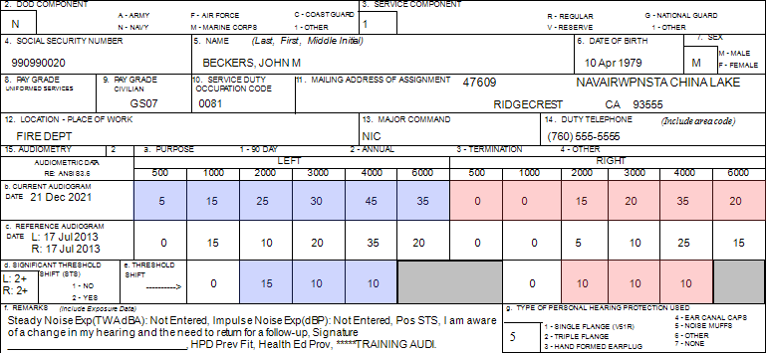
Page 96; Confirm demographic fields 2 thru 14; Is there a change in hearing (ear specific)? Are thresholds within the range of normal (ear specific)? Where does the patient need to go? Additional Comments?
Notes:
Provide normal parameters of hearing; explanation of an STS and other data that may be included in remarks section
Remarks on the 2216 are specific to the latest test on the 2216
Student can look at data in their own database, viewing the 990990020 DD Form 2216 tests in the print window to observe/review
What happens when the patient comes back? Their threshold levels at that time?

Slide 24
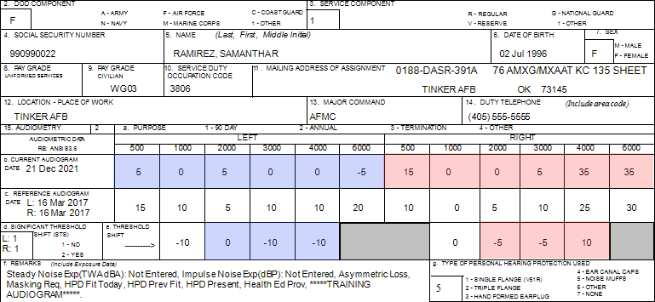
Page 96; Confirm demographic fields 2 thru 14; Is there a change in hearing (ear specific)? Are thresholds within the range of normal (ear specific)? Where does the patient need to go? Additional Comments?
Notes:
Patient history: USAF civilian, Sheet Metal Mechanic
Student can look at data in their own database, viewing the 990990022 DD Form 2216 in the print window to observe/review
Asymmetry, masking requirement

Slide 25
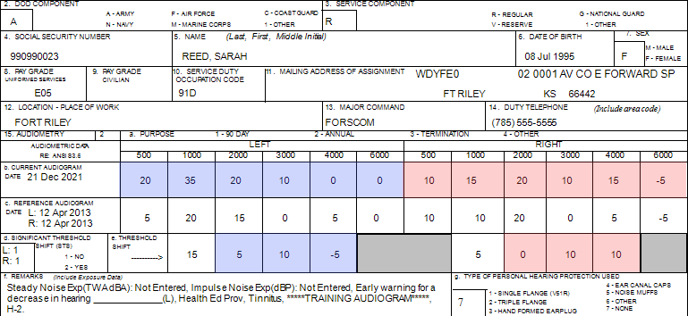
Page 97; Confirm demographic fields 2 thru 14; Is there a change in hearing (ear specific)? Are thresholds within the range of normal (ear specific)? Where does the patient need to go? Additional Comments?
Notes:
USA Patient was previously an H-1, this audiogram they are an H-2, USA uses better ear for profiling; profile change requires referral to audiologist. Possibly has conductive issues, bringing down 1000 Hz Left ear would revert back to a H-1… Also looking at patient history, a tech did a reference type 2 instead of an annual test in 2018. Note: HPDs = none (discuss)
Student can look at data in their own database, viewing the 990990023 DD Form 2216 in the print window to observe/review

Slide 26
Counseling Strategies
Tips
If validity of test results is in question and reinstructing patient is not successful, refer patient to Professional Supervisor
Ensure patient privacy
Fit and counsel patients on the use of hearing protection whether or not hearing has changed
Counseling session equals patient education
Do not diagnose hearing loss
  Pure tone air conduction is not a diagnostic hearing evaluation
  Test cannot identify the type of hearing loss or the possible presence of a medical pathology
Results of the diagnostic hearing evaluation will determine type of hearing loss and whether a referral to a medical doctor is necessary

Slide 27
Counseling Strategies
Summary
Counseling
Audiogram forms/fields
Counsel a patient on their audiogram
Describe the required follow-up steps for a STS and/or referrals
Group explanation of test results
Demonstration and role-play
Tri-Service Hearing Technician 4.2.0.0 Certification Course

Slide 28
Counseling Strategies
? Questions ?
Tri-Service Hearing Technician
4.2 Certification Course

